Slide 1
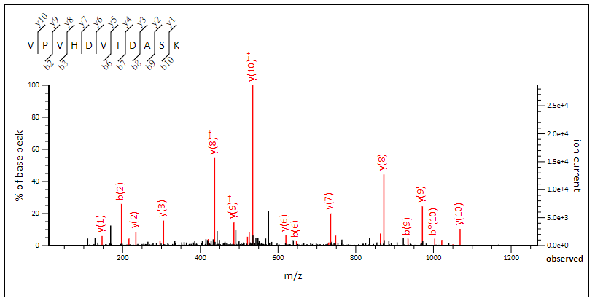
Determine the sequence of the fully tryptic peptide given the following experimental tandem mass spectrum
Exp. m/z: 584.303955, Charge: 2+
# | b+ | Seq. | y+ | #
1 |  | V |  | 11
2 | 197.1285 | P | 1068.5320 | 10
3 | 296.1969 | V | 971.4793 | 9
4 |  | H | 872.4108 | 8
5 |  | D | 735.3519 | 7
6 | 647.3511 | V | 620.3250 | 6
7 | 748.3988 | T | 521.2566 | 5
8 | 863.4258 | D | 420.2089 | 4
9 | 934.4629 | A | 305.1819 | 3
10 | 1021.4949 | S | 234.1448 | 2
11 |  | K | 147.1128

Slide 2
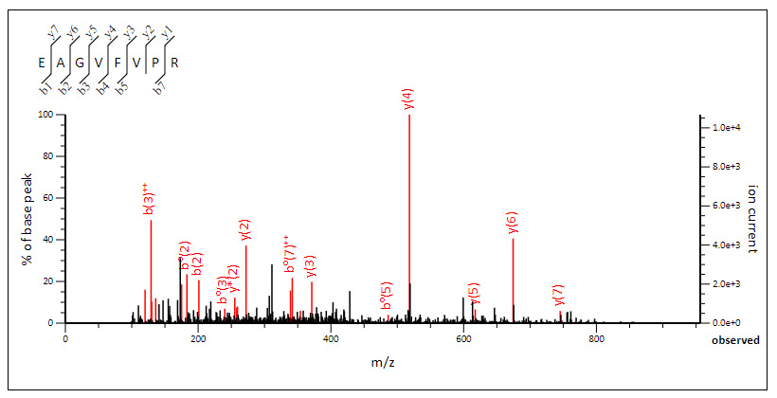
Determine the sequence of the fully tryptic peptide given the following experimental tandem mass spectrum
Exp. m/z: 437.742798, Charge: 2+
# | b+ | Seq. | y+ | #
1 | 130.0499 | E |  | 8
2 | 201.0870 | A | 745.4355 | 7
3 | 258.1084 | G | 674.3984 | 6
4 |  | V | 617.3770 | 5
5 |  | F | 518.3085 | 4
6 |  | V | 371.2401 | 3
7 |  | P | 272.1717 | 2
8 |  | R | 175.1190 | 1

